Slide 1
BANK CUSTOMER UK
Presentation
Abhinav Mishra

Slide 2

CONTENTS
01 - Introduction
02 - Project goals and objectives
03 - Requirements
04 - Implementation strategy
05 - Visualization
06 - Infromation
07 - Conclusions

Slide 3

INTRODUCTION
"Opportunity knocks, but it doesn't wait"
Welcome to our comprehensive UK Bank Customer Power BI Report! This dynamic and insightful dashboard has been meticulously crafted to provide our esteemed financial institution with a clear and comprehensive understanding of our customer base across the United Kingdom.

Slide 4

PROJECT GOALS AND OBJECTIVES
Our project aims to create a user-friendly Power BI report providing valuable insights into our banking customer data. The report includes slicers for gender, job classification, and region, as well as key metrics like total balance and customer analysis. Dynamic visualizations showcase age distribution, average balance by region, and job classification trends over time. Custom tooltips and synchronized slicers enhance interactivity, while page navigation and bookmarks ensure seamless exploration of data. This comprehensive report equips stakeholders with the tools needed for data-driven decision-making and strategic planning in the competitive banking landscape.

Slide 5

REQUIREMENTS
"Invest in knowledge and training"
1 Slicers for Gender, Job Classification, Region
2 Total Balance
3 First and Last Customer
4 Customer with Highest Balance
5 Age with most number of Customers
6 Average Balance for Each Region
7 Average Balance between Different Job Classifications
8 Graph of Customers (Different Lines for each Job Classification) vs Month
9 Total Balance and Number of Customers for Each Region in a Multi Card Visual
10 Use of Custom Tooltips
11 Page Navigation
12 Bookmarks
13 Sync Slicers across Report

Slide 6
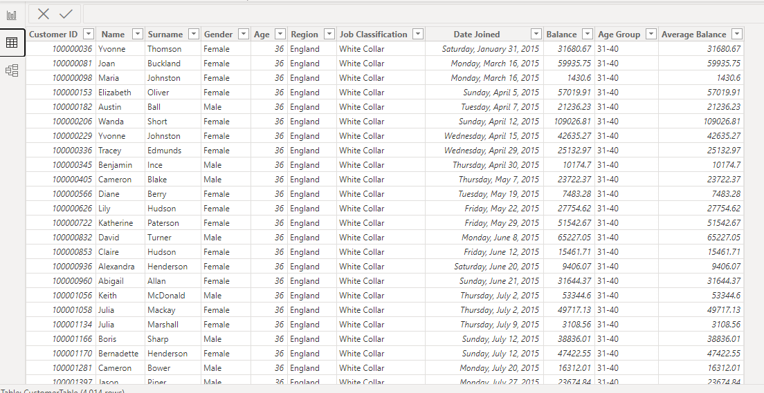
IMPLEMENTATION STRATEGY

Slide 7
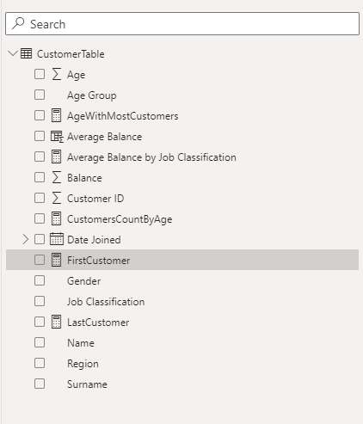
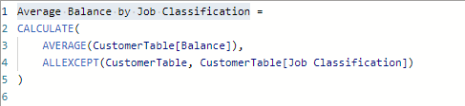
According to the need of the reuirement table we have created mesures that are required by the client for instance there was need to create a "Average Balance by Job Classification" so for that we have made a new measure in the data table .
f

Slide 8
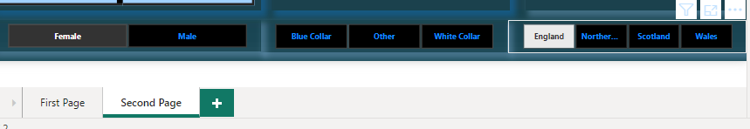
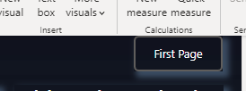
SLICERS FOR GENDER, JOB CLASSIFICATION, REGION
PAGE NAVIGATION

Slide 9
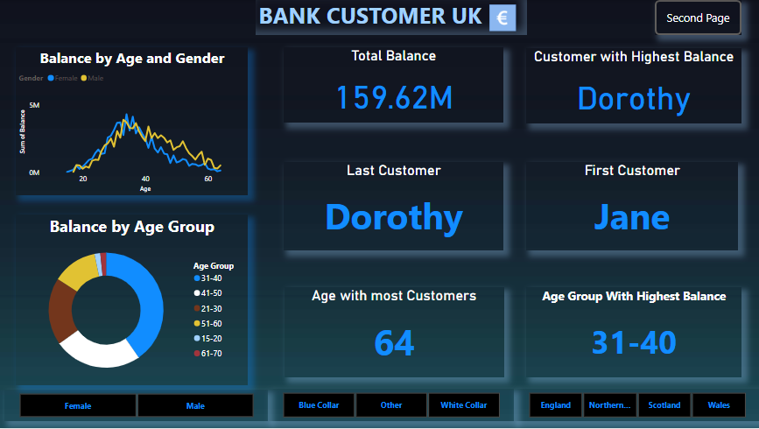
FINANCIAL PROJECTIONS
This is the first page with all the requirement by the client displaying all the necessary visualization with interactive graphs, cards along with buttons and slicers.

Slide 10
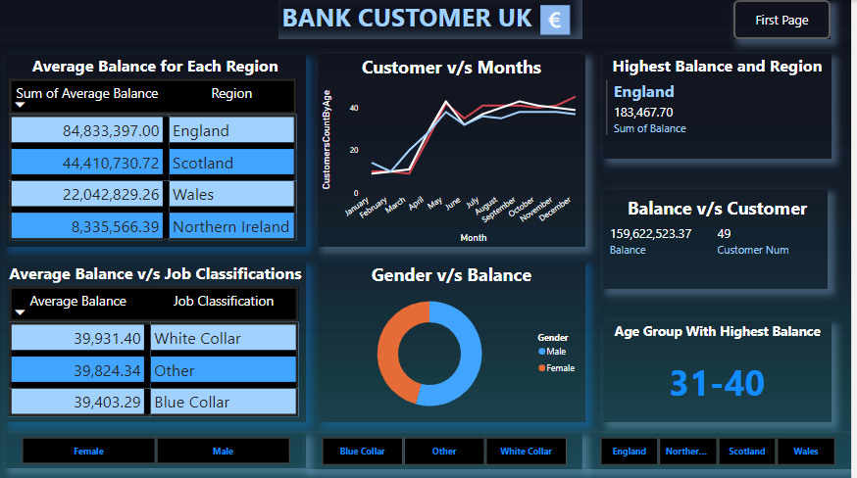
FINANCIAL PROJECTIONS
This is the second page with all the requirement by the client displaying all the necessary visualization with interactive graphs, cards along with buttons and slicers.

Slide 11

CONCLUSIONS
In conclusion, the Power BI report I have created offers valuable insights for our banking institution. It's a user-friendly and interactive dashboard with key metrics, dynamic visualizations, and customer analysis. The accompanying PowerPoint provides an overview, but the complete Power BI report contains even more informative content.
It is important to note that the PowerPoint presentation accompanying this report serves as a concise overview, offering a glimpse into the rich and informative content present in the complete Power BI report. The Power BI report dilevers deeper into the data, providing comprehensive visualizations and detailed analyses that can guide our institution's key decisions and actions.

Slide 12
THANKS
Presentation
Abhinav Mishra 2029167@kiit.ac.in

